Slide 1




NEXT GEN EMPLOYABILITY PROGRAM
Creating a future-ready workforce
Team Members
College Name
Student Name :AISHA..A
Student ID : au960221104011
Arunachala College Of Engineering For Women

Slide 2

CAPSTONE PROJECT SHOWCASE
Project Title
Car Rentals Application with Django Framework
Abstract | Problem Statement | Project Overview | Proposed Solution | Technology Used | Modelling & Results | Conclusion

Slide 3
Abstract
In an era characterized by rapid technological advancement and dynamic global economic landscapes, the traditional paradigms of employability are undergoing significant transformations. The Next-Generation Employability Program (NGEP) is a comprehensive initiative designed to address the evolving needs of the workforce and equip individuals with the requisite skills to thrive in the jobs of tomorrow.
This program adopts a multifaceted approach, integrating elements of education, training, mentorship, and industry engagement to cultivate a versatile and adaptable workforce. Central to the NGEP is its emphasis on fostering not only technical proficiencies but also soft skills such as critical thinking, creativity, communication, and emotional intelligence. Recognizing the interconnectedness of diverse disciplines, the curriculum is designed to promote interdisciplinary learning, enabling participants to navigate complex challenges with agility and innovation.
Source :

Slide 4
Problem Statement
In today's rapidly evolving job market, traditional education systems often fail to equip individuals with the skills necessary to succeed in dynamic and diverse workplaces. This gap between the skills demanded by employers and those possessed by job seekers has led to unemployment, underemployment, and a mismatch in talent allocation. Moreover, certain demographic groups, including minorities, individuals from low-income backgrounds, and those with disabilities, face systemic barriers that hinder their access to meaningful employment opportunities. Additionally, rapid technological advancements and globalization further exacerbate the challenges, necessitating a new approach to workforce development.
Source :

Slide 5
Project Overview
Overview: The Next-Generation Employability Program (NGEP) is a groundbreaking initiative designed to address the evolving needs of the workforce and equip individuals with the skills and support necessary to thrive in the jobs of tomorrow. Developed in response to the challenges posed by rapid technological advancement, globalization, and shifting workplace dynamics, NGEP represents a collaborative effort between educational institutions, industry partners, and community organizations to bridge the gap between education and employment and foster a more inclusive and resilient workforce.
Source :

Slide 6
Proposed Solution
The Next-Generation Employability Program (NGEP) presents a comprehensive solution to address the aforementioned challenges and bridge the gap between education and employment. The program focuses on several key components:
Integrated Curriculum: NGEP designs a curriculum that combines technical skills training with the development of essential soft skills such as communication, critical thinking, problem-solving, and adaptability. This integrated approach ensures that participants are equipped with the well-rounded skill set demanded by modern workplaces.
Experiential Learning: NGEP emphasizes hands-on, experiential learning opportunities to provide participants with practical, real-world experience. Internships, apprenticeships, industry projects, and simulations enable individuals to apply their knowledge in professional settings, thereby enhancing their employability and readiness for the workforce.
Industry Partnerships: NGEP collaborates closely with industry partners to ensure that its curriculum remains relevant and aligned with current market demands. By engaging employers in the program's design and implementation, NGEP facilitates seamless transitions from education to employment and provides participants with access to job opportunities, mentorship, and networking opportunities.
Source :

Slide 7
Inclusivity and Diversity: NGEP prioritizes inclusivity and diversity, striving to reach individuals from diverse backgrounds and underserved communities. The program offers tailored support and resources to address the unique needs and challenges faced by different demographic groups, thereby promoting equal access to employment opportunities and fostering a more inclusive workforce.
Lifelong Learning: NGEP instills a culture of lifelong learning and continuous skill development among participants. Through ongoing support, mentorship, and access to resources, the program empowers individuals to adapt to changing job market trends, acquire new skills, and pursue opportunities for career advancement throughout their professional journeys.
Mentorship and Coaching: Implement a structured mentorship and coaching program where participants are paired with experienced professionals in their field of interest. Mentors provide guidance, advice, and industry insights, helping participants navigate their career paths, set goals, and overcome challenges.
Source :

Slide 8
Entrepreneurship Support: Offer resources and support for aspiring entrepreneurs within the NGEP framework. This could include workshops on business planning, access to funding opportunities, mentorship from successful entrepreneurs, and networking events with investors and industry leaders.
Language and Intercultural Communication Training: Provide language learning opportunities and intercultural communication training to prepare participants for globalized workplaces. Multilingualism and cultural competency are increasingly valued skills in diverse and interconnected industries.
Financial Literacy Education: Offer workshops and resources on financial literacy, budgeting, saving, and investing to empower participants with the knowledge and skills to manage their finances effectively. Financial stability is essential for long-term career success and personal well-being.
Remote Work and Digital Nomadism Training: With the rise of remote work and digital nomadism, provide training on remote collaboration tools, time management, self-discipline, and work-life balance in virtual environments. Equip participants with the skills to thrive in flexible work arrangements.
Source :

Slide 9


Technology Used
Front-end
Back-end
Source :

Slide 10
Modelling & Results
Modeling the NGEP:
Participant Enrollment: Assume the NGEP aims to enroll a diverse group of participants, including recent graduates, mid-career professionals seeking upskilling, and individuals from underrepresented communities. Target enrollment for the first year is 500 participants.
Program Duration: The NGEP is designed as a one-year intensive program, comprising a blend of classroom instruction, hands-on projects, internships, mentorship, and career coaching.
Results for NGEP:
Participant Outcomes: Measure participant outcomes such as employment rate, job placement in relevant fields, salary increases, career advancement, and satisfaction with the program.
Source :

Slide 11
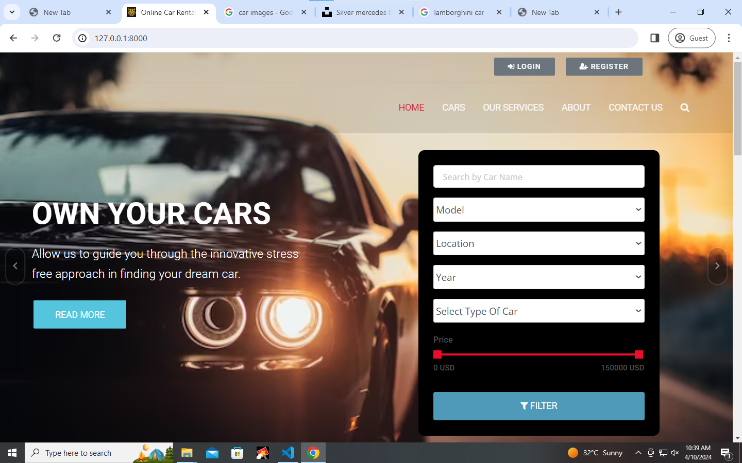
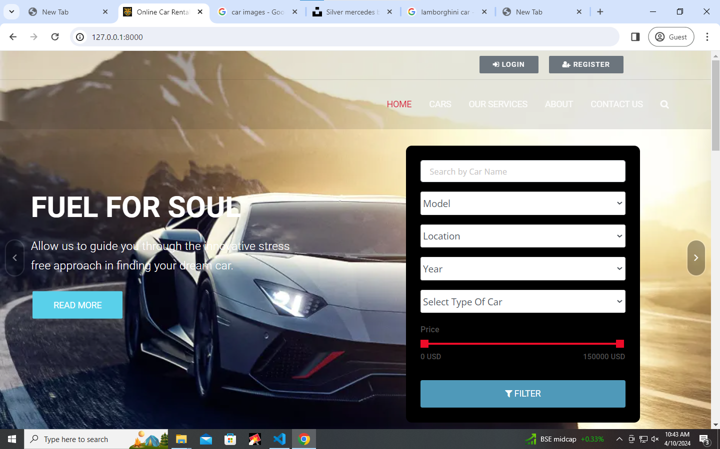
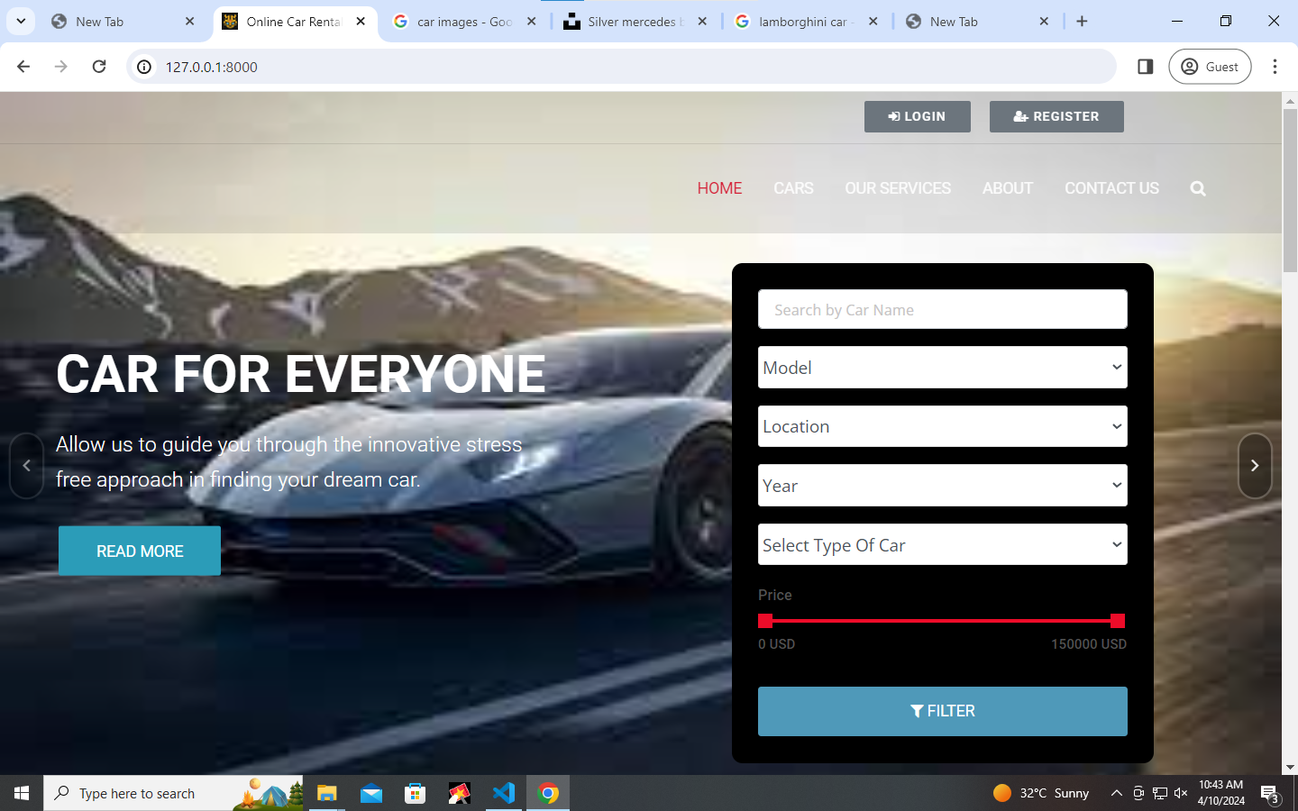
Homepage

Slide 12
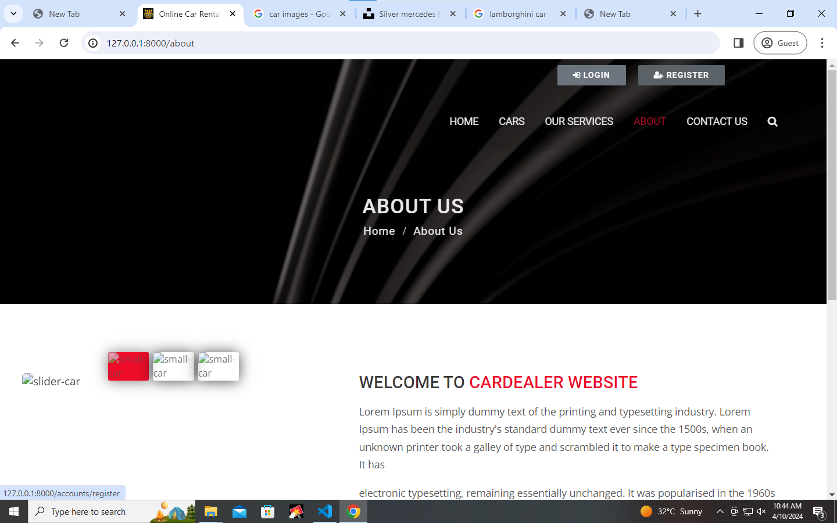
About-Us-Page

Slide 13
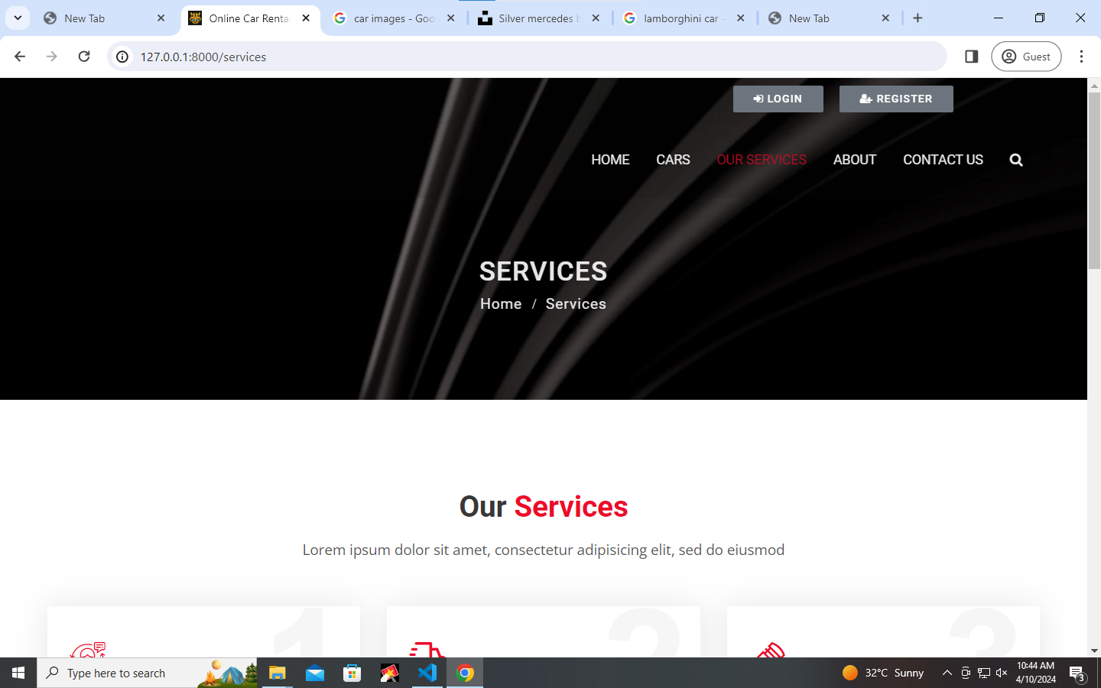
Service-Page

Slide 14
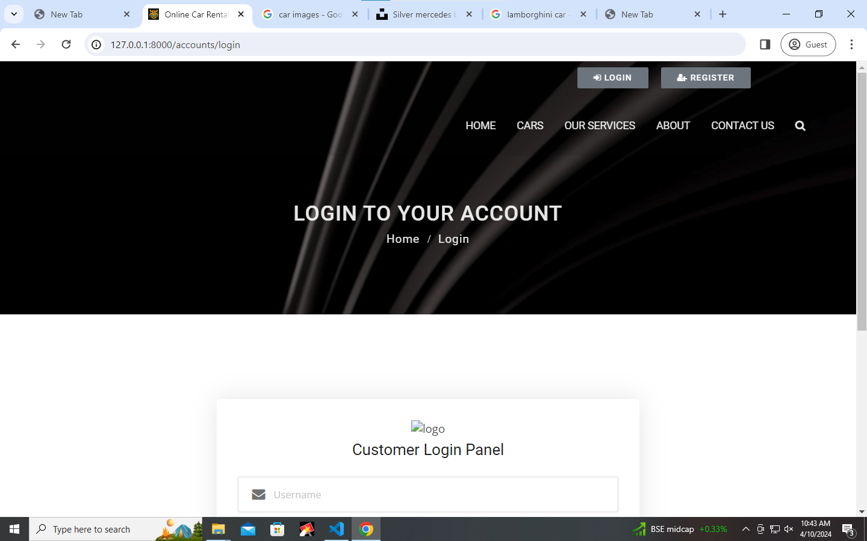
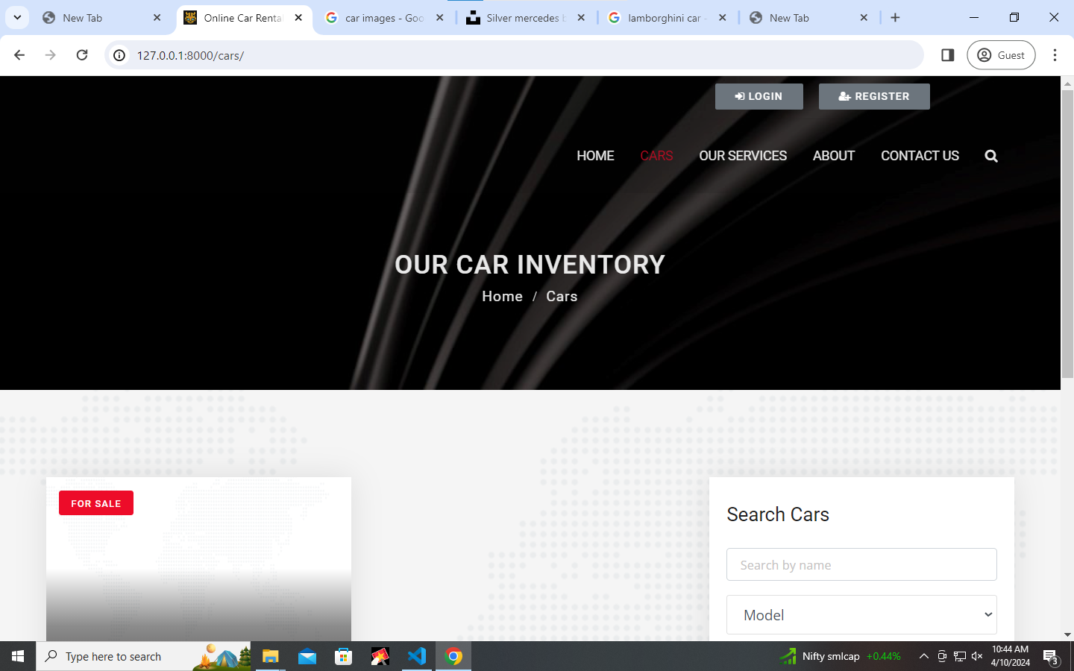
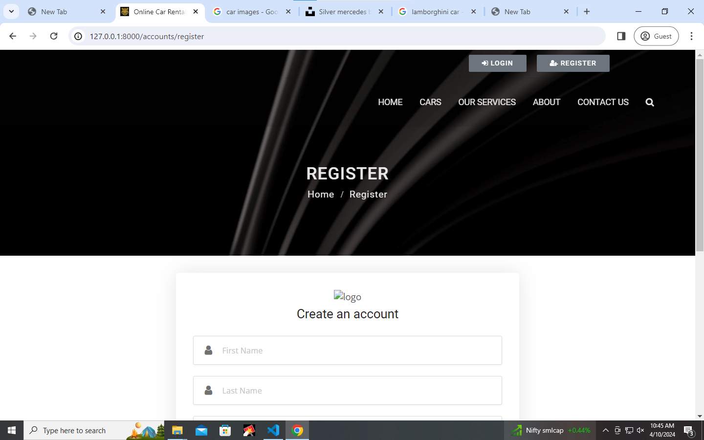
Departments-Page

Slide 15
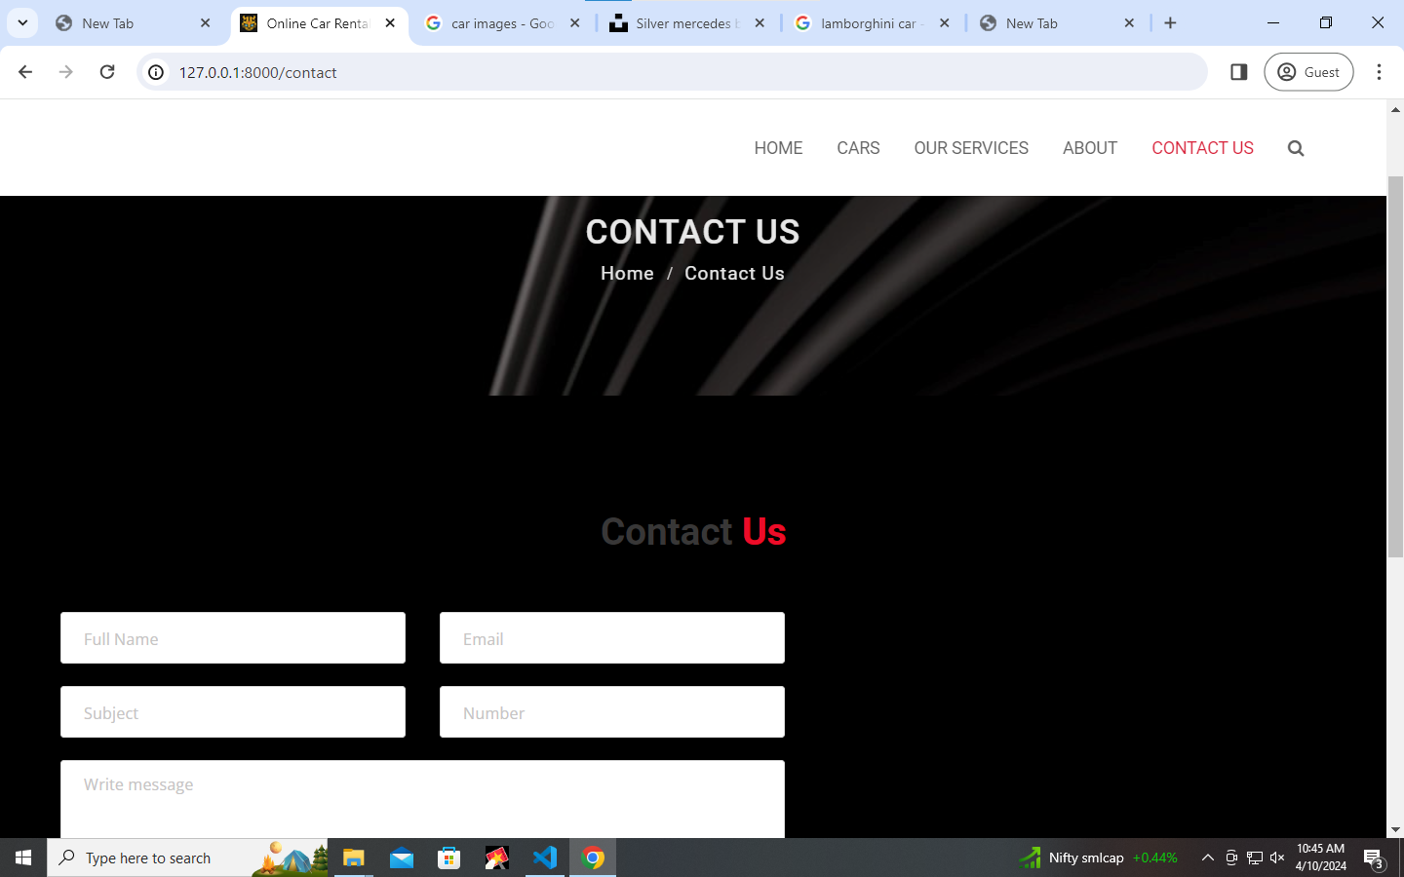
Blog-Page

Slide 16
Future Enhancements:
Integration with GPS/Navigation Services: Integrate with GPS/navigation services to provide directions to pick-up/drop-off locations and enhance the overall user experience.
Fleet Management: Develop a backend system for managing the fleet of cars, including tracking maintenance schedules, mileage, insurance status, and other relevant information.
Loyalty Programs and Discounts: Implement loyalty programs to reward frequent users with discounts, special offers, or points redeemable for future rentals.
Integration with GPS/Navigation Services: Integrate with GPS/navigation services to provide directions to pick-up/drop-off locations and enhance the overall user experience.
Fleet Management: Develop a backend system for managing the fleet of cars, including tracking maintenance schedules, mileage, insurance status, and other relevant information.
Loyalty Programs and Discounts: Implement loyalty programs to reward frequent users with discounts, special offers, or points redeemable for future rentals.

Slide 17
Conclusion
.
The success of NGEP is evident in its measurable outcomes, including high employment rates, salary increases, employer satisfaction, and community impact. By equipping participants with the skills and resources to build successful careers, NGEP contributes to economic growth, social mobility, and diversity and inclusion in the workforce.
In conclusion, the Next-Generation Employability Program (NGEP) represents a forward-thinking and impactful approach to workforce development, empowering individuals to realize their full potential and contribute meaningfully to society in the rapidly evolving job market of the future.
Source :

Slide 18
Thank You!
Notes:
Thank You !!

